Slide 1

TechForAll CompU Database
IST 659
Team 2
William Blumrosen
Caitlin Rookey
Woo Song
Olana Wesley

Slide 2
Introduction
The foundation, TechForAll, solicits technology donations for students across the city. The devices are distributed by criteria determined by the foundation’s board of directors. The CompU database tracks the requests made by students to receive a device from the charity and the inventory of devices waiting to be distributed.

Slide 3
Stakeholders
Students
Donors
TechForAll Foundation

Slide 4
Goal
The goal of the database is to manage the requests, distribution, and inventory of gifted devices.

Slide 5
Data Questions
How can we notify a donor once their donated laptops have been given to a student?
How many students from each district have requested devices?
Who are our top donors?
How many students from each district have been approved for device allocation?
How many laptops and tablets are currently available in the inventory?
How will students be measured against GPA, disability, grade, and district, etc.?

Slide 6
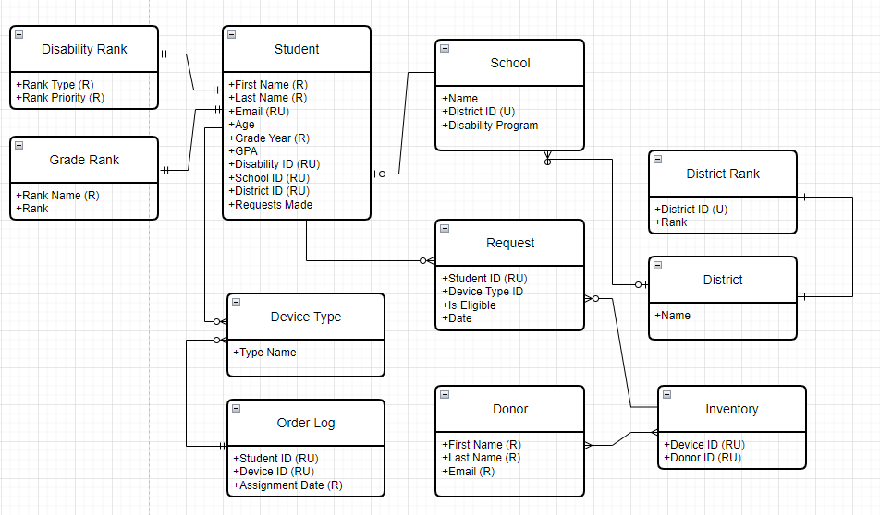
Conceptual Model

Slide 7
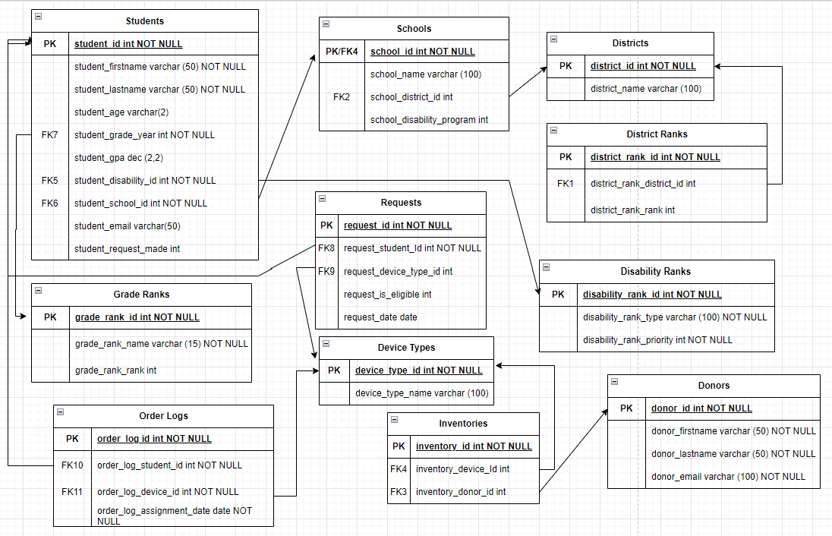
Logical Model

Slide 8
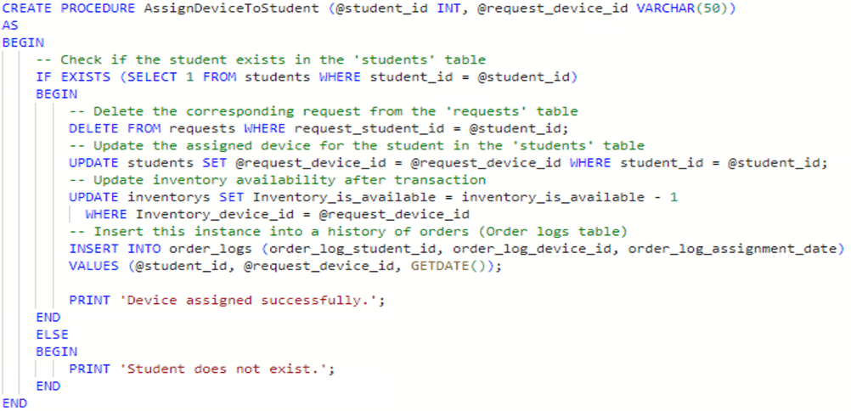
How can we notify a donor once their donated device has been given to a student?
To first initiate this question, we must create a procedure that executes that a device has been assigned to a student.
The inputs for this procedure will be "student e-mail" & "device type"

Slide 9
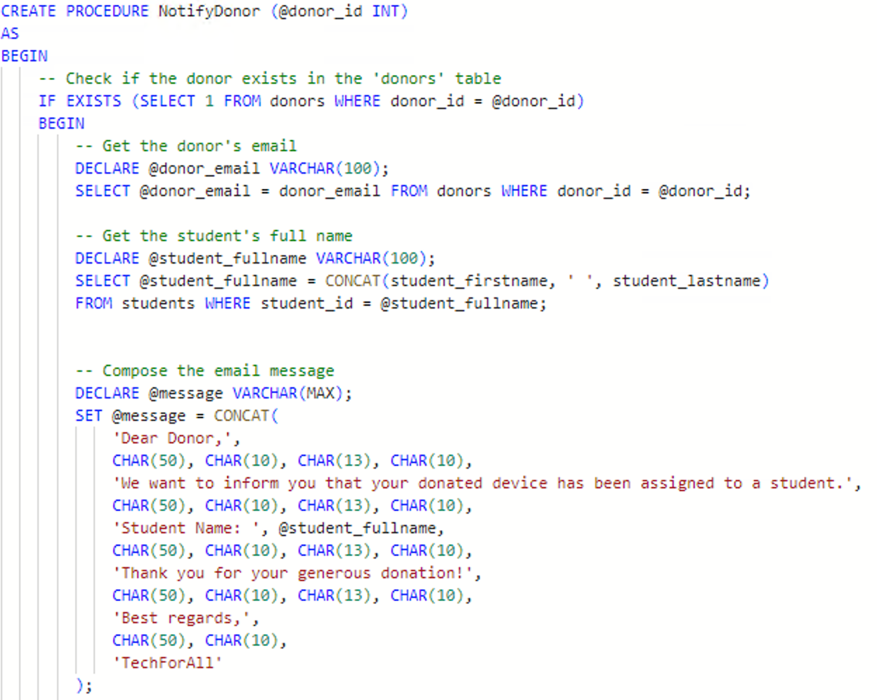
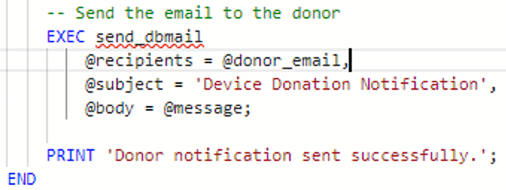
How can we notify a donor once their donated device has been given to a student? (Cont.)
To notify donors of their completed donation, we can create another procedure with the only input being "donor ID". This includes a set of declarations to grab donor and student information
We can then execute an e-mail sending logic to include the declared recipient and templated message body.

Slide 10
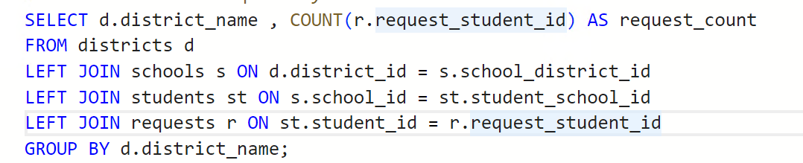
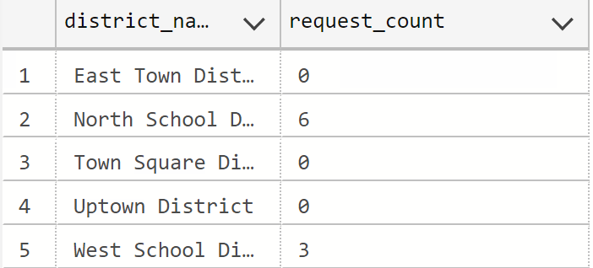
How many students from each district have requested devices?
To answer this question we need a select statement that joins tables "districts" and "requests"
The inputs for the select statement are "district name" and the count of requests made by students labeled as "request_count"

Slide 11
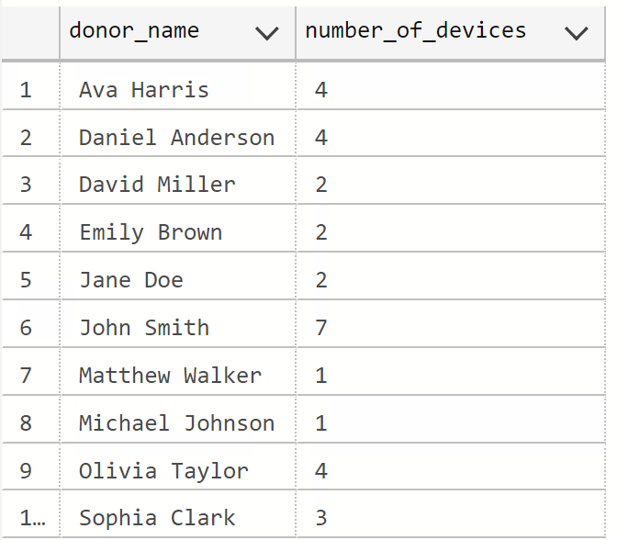
Who are our top donors?
To answer this question we need to join the donors table with the inventory table to see how many devices in the inventory are from individual donors.

Slide 12
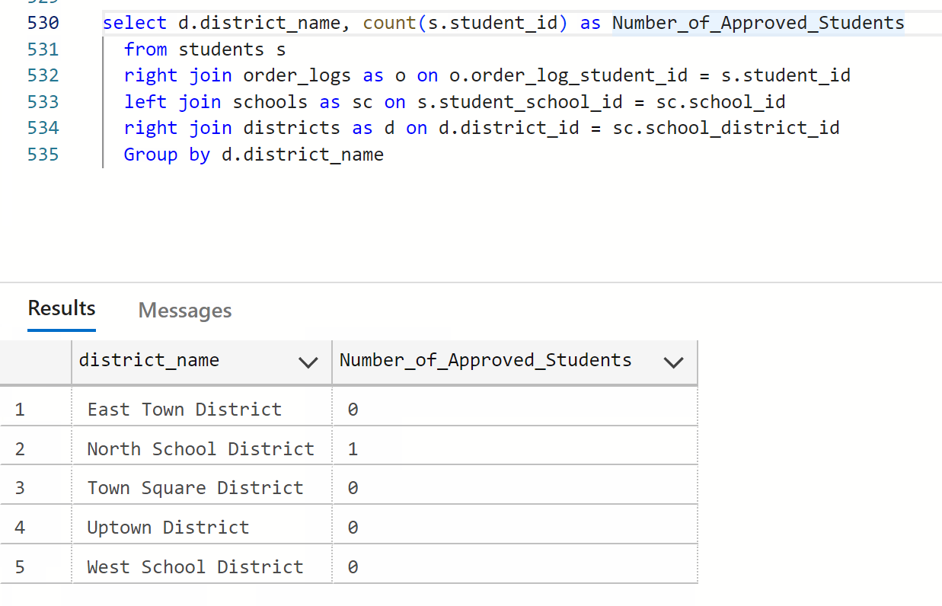
How many students from each district have been approved for device allocation?
To achieve this we needed to join the order log table with the district table to see the number of approved students by district.

Slide 13
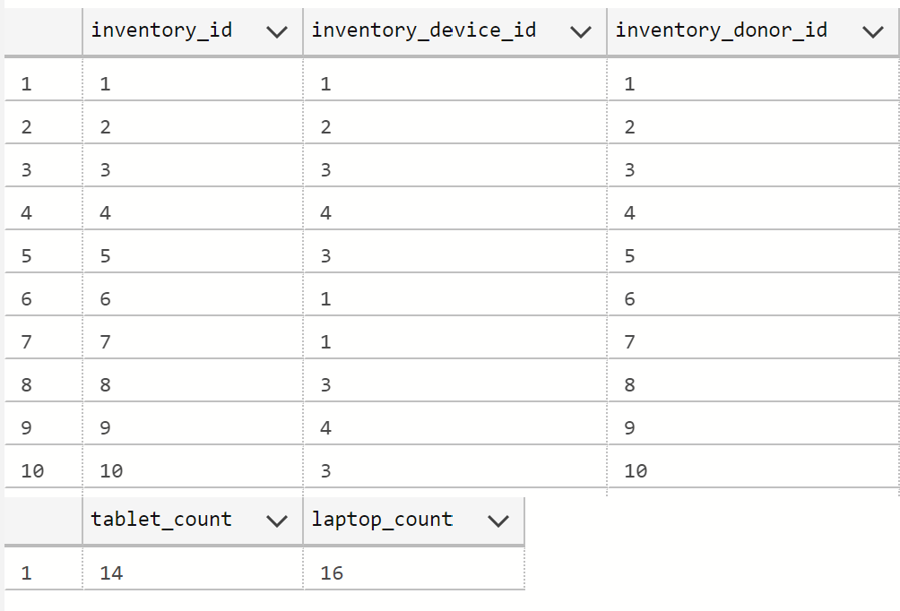
How many laptops and tablets are currently available in the inventory?
To answer this question we need to add together the device types create 2 counts: tablet_count and laptop_count
select * from inventorys
SELECT
SUM(CASE WHEN inventory_device_id IN (1,2) THEN 1 ELSE 0 END) AS tablet_count,
SUM(CASE WHEN inventory_device_id IN (3,4) THEN 1 ELSE 0 END) AS laptop_count
FROM
inventorys

Slide 14
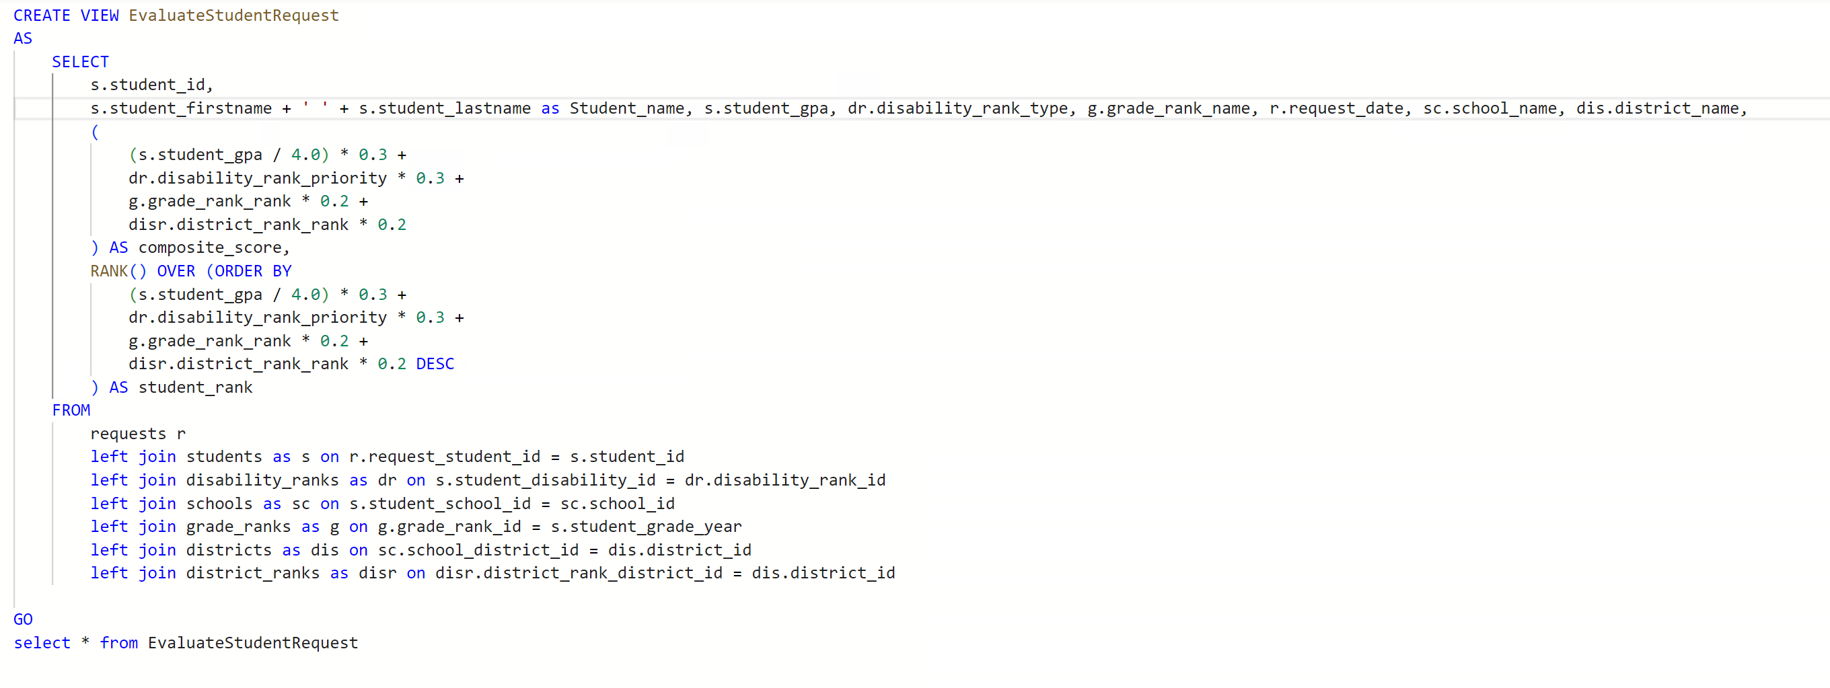
How will students be measured against GPA, disability, grade, and district?
To do this we need to weigh the value of each student by assigning a weight to each field based on their GPA, disability, grade, and district
Each request is ranked by which one needs the most attention

Slide 15
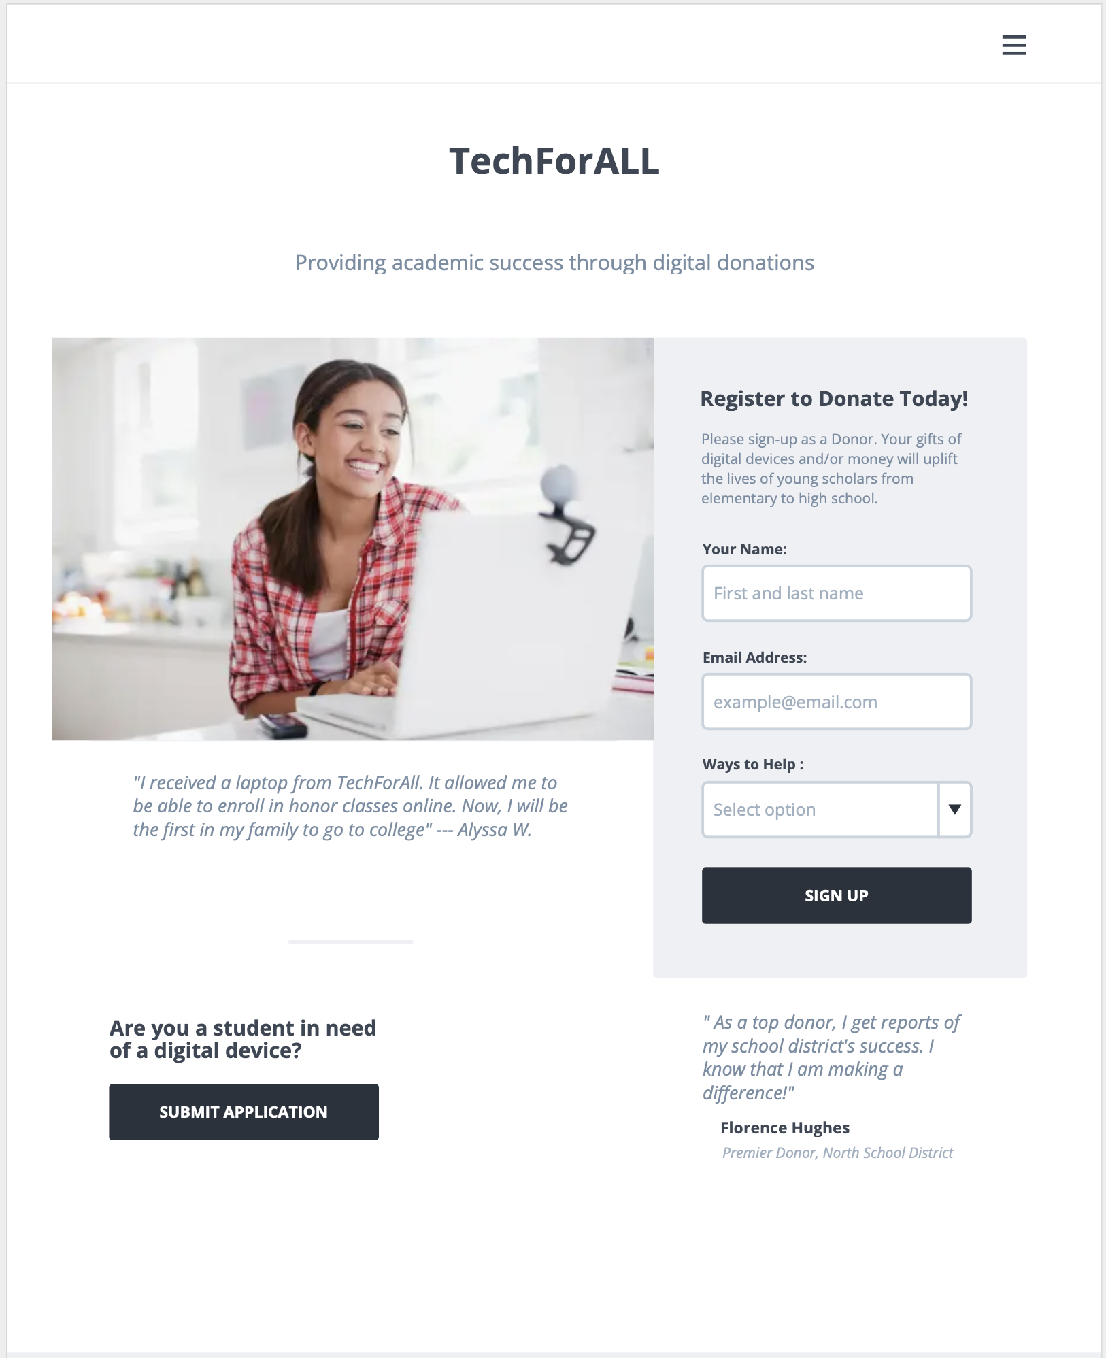
Application Wireframe
The TechForAll interface acts as a bridge between the donors and the students that need digital equipment.
Once a donor signs up with their name and email, their profile is created. From their profile, donors are now able to make donations, see their contribution status, as well as observe how well TechForAll is performing.
Students are also able to submit applications for equipment.

Slide 16
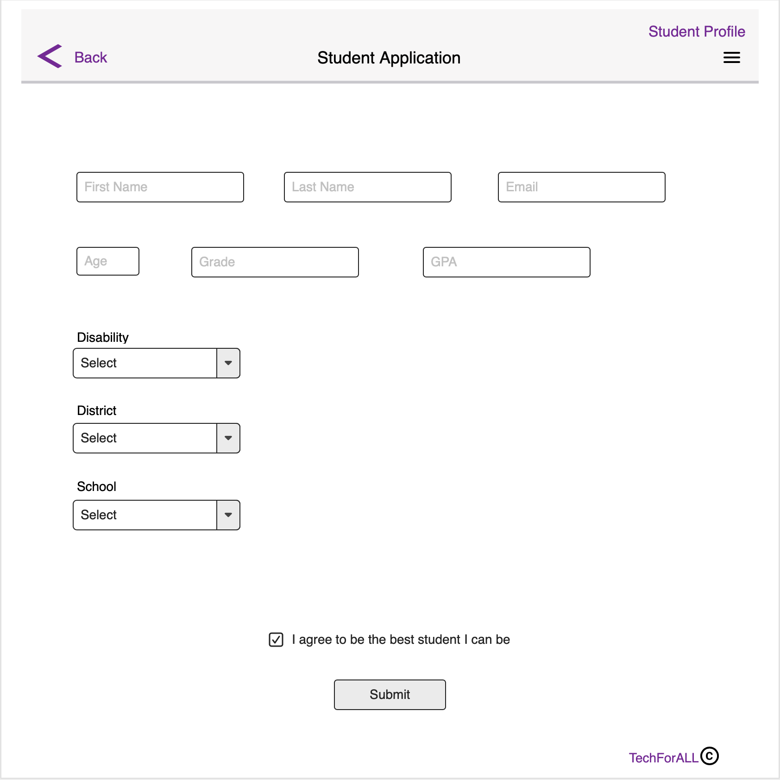
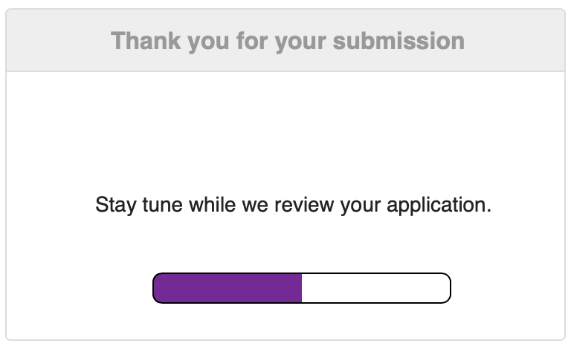

Slide 17
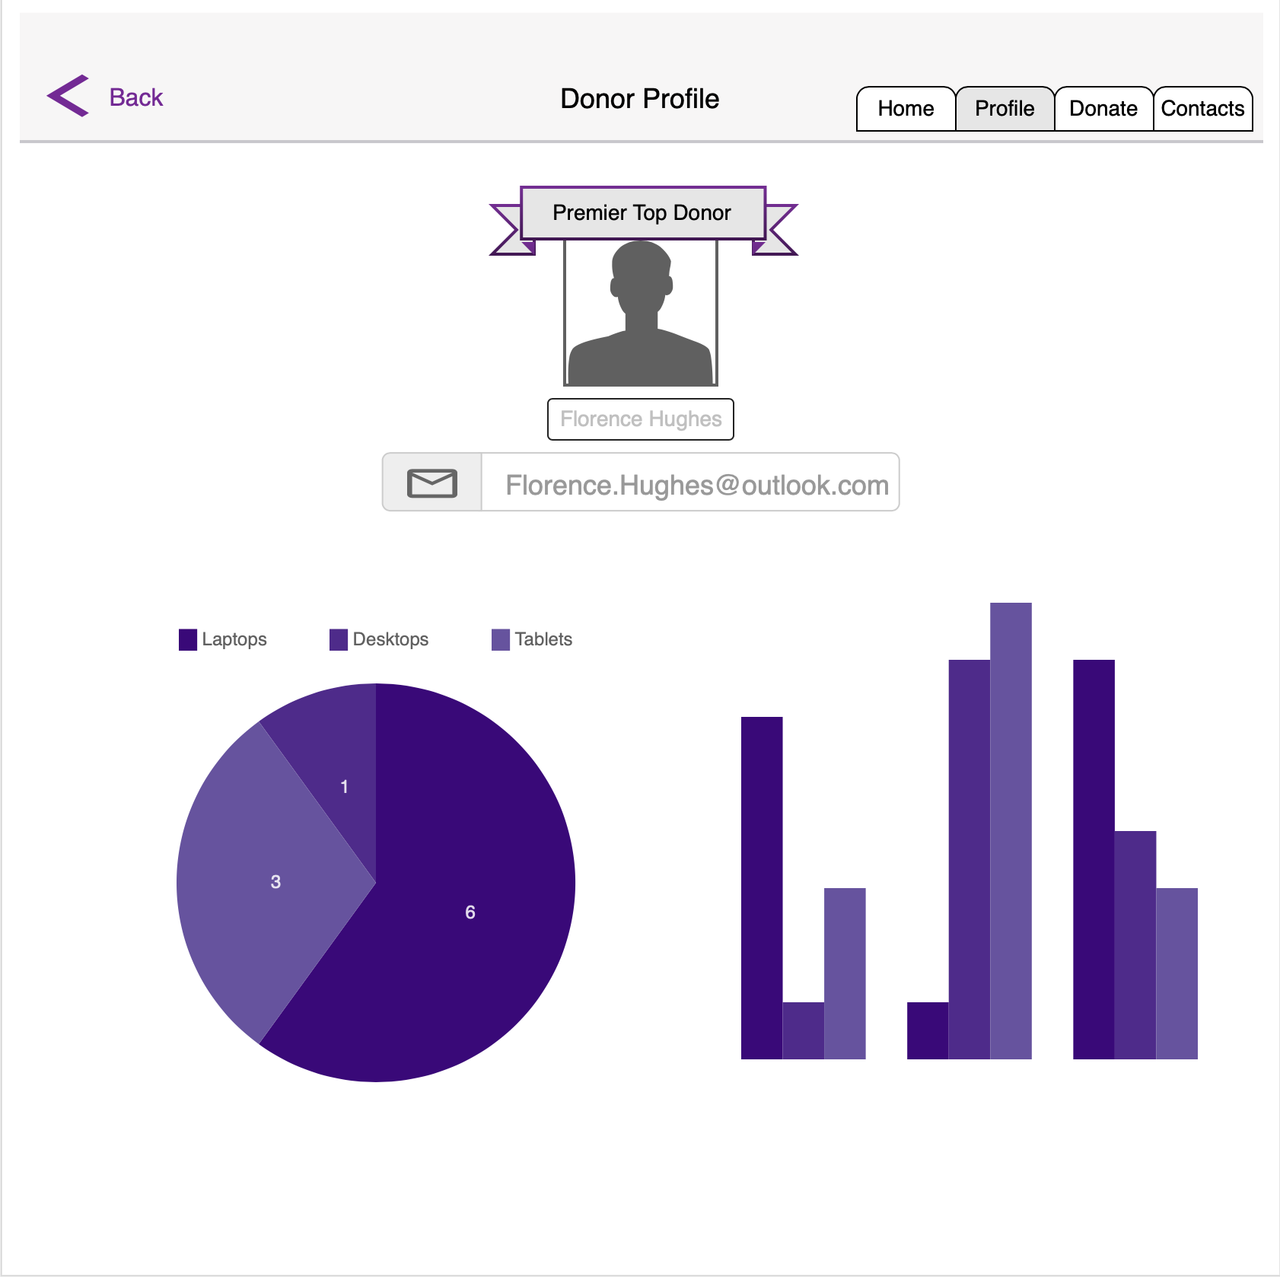
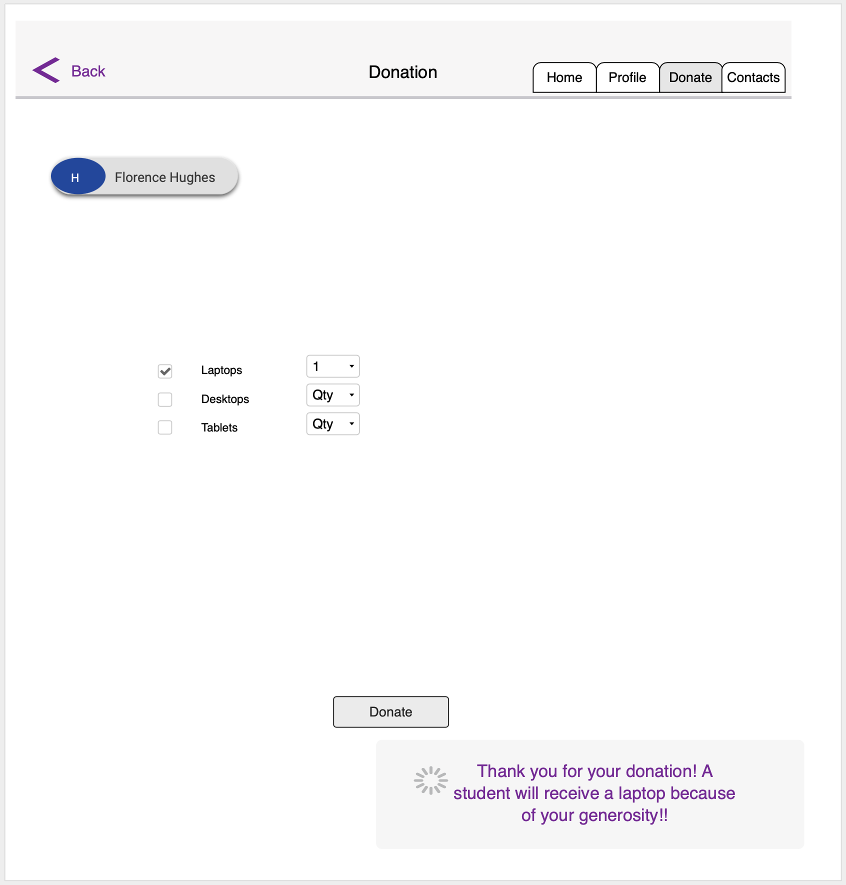

Slide 18
Reflection
Overall, this project helped up better understand the importance of SQL and doing the proper steps before creating the database such as the conceptual and logical models.
If we could do it again, adding in more data points and showcasing what the model looks like after a few months would help us understand how well our database was built

